Slide 1
I211 – Information Infrastructure II
Lecture 20

Slide 2
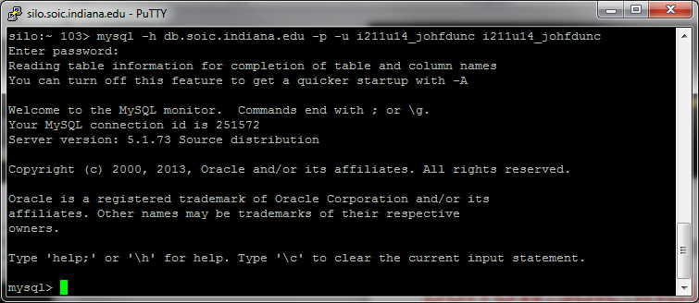
Logging Into MySQL
Use PuTTY to connect to:
burrow.soic.indiana.edu
  Login as your IU account
At the prompt, type:
mysql -h db.soic.indiana.edu –p –u i211u14_username i211u14_username
(Replace ‘username’ with yours)
Your Password: my+sql=i211u14_username

Slide 3
Bonus Points!
All of today’s lecture work is for Bonus Points.
If you don’t want to try it, you can work on the HW instead.
Online Evaluations – If the response rate passes 80%, I’ll give everyone 3 Bonus Points on the Final Exam!

Slide 4
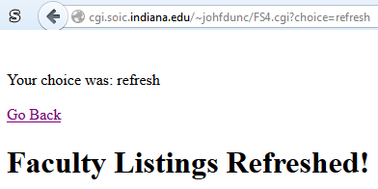
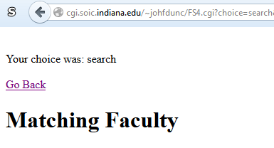
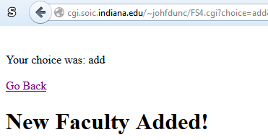
Faculty Search pt 4 (Group Work)
Create an .html page to go with your .cgi page (you can copy mine from here: http://cgi.soic.indiana.edu/~johfdunc/FS4.html
Have your .cgi page detect the differences between clicking the Import link, the Find Faculty button, and the Add Faculty button.
It should print out the value of choice (in the URL) and an appropriate message:

Slide 5
Faculty Search pt 4 (Solution)
#! /usr/bin/env python
print 'Content-type: text/html\n'
import MySQLdb, urllib, xml.etree.ElementTree as ET, cgi
form = cgi.FieldStorage()
choice = form.getfirst("choice", "refresh")
print "Your choice was:", choice
print '<p><a href="FS4.html">Go Back</a></p>'
if choice == 'refresh':
print "<h1>Faculty Listings Refreshed!</h1>"
elif choice == 'search':
print "<h1>Matching Faculty</h1>"
elif choice == 'add':
print "<h1>New Faculty Added!</h1>"

Slide 6
Faculty Search pt 5 (Group Work)
If the user clicks the “Import Faculty from Web” link, it should run the code you wrote for pt 3, and import a fresh copy of the data from the SoIC faculty page.
If the user clicks the Name or Title columns in the table, the data should be sorted by those values (don’t re-import the data!) HINT: Use a different value of ‘choice’ for sort – take a look at my URLs.
You can view a live version here:
  http://cgi.soic.indiana.edu/~johfdunc/FS5.html

Slide 7
Faculty Search pt 5 (Solution pt 1)
#! /usr/bin/env python
print 'Content-type: text/html\n'
import MySQLdb, urllib, xml.etree.ElementTree as ET, cgi
def open_page(page):
try:
web_page = urllib.urlopen(page)
lines = web_page.read()
if "404 Page Not Found" in lines:
print "That page doesn't exist on the server."
web_page.close()
except:
print "Error opening that URL!"
lines = []
return lines
def results_table(records):
#display data from DB
print "<html><body><table border='1' width='100%'>"
print "<tr><th>FacultyID</th><th><a href='FS5.cgi?choice=sort&type=Name'>Name</a></th>"
print "<th><a href='FS5.cgi?choice=sort&type=Title'>Title</a></th><th>Email</th><th>Areas</th><th>Picture</th></tr>"
for row in records:
print "<tr>"
for i in range(len(row)):
if i != 5:
print "<td align='center'>", row[i],"</td>"
else:
print "<td align='center'><img src='http://www.soic.indiana.edu" + row[i] + "'></td>"
print "</tr>"
print "</table></body></html>"
form = cgi.FieldStorage()
choice = form.getfirst("choice", "refresh")
stype = form.getfirst("type", "Name")
print '<p><a href="FS5.html">Go Back</a></p>'

Slide 8
Faculty Search pt 5 (Solution pt 2)
#establish DB connection
string = "i211u14_username" #change this to yours
password = "my+sql=i211u14_username" #change this to yours
db_con = MySQLdb.connect(host="burrow.soic.indiana.edu", port = 3306, user=string, passwd=password, db=string)
cursor = db_con.cursor()
if choice == 'refresh':
print "<h1>Faculty Listings Refreshed!</h1>"
lines = open_page("http://www.soic.indiana.edu/people/faculty.shtml")
faculty_list = []
if lines:
#read data from page
faculty = ET.XML(lines).findall("body/div/div/div/div/div/table/tbody/tr")
for item in faculty:
info = []
info.append(item.find("td/h3/a").text.encode('utf-8'))
info.append(item.find("td/p").text)
emails = item.findall("td/p/span/span")
if emails:
info.append(emails[0].text + "@" + emails[1].text)
else:
info.append("None Listed")
interests = item.findall("td/ul/li")
if interests[0].text:
info.append(",".join([bit.text for bit in interests if bit.text]))
else:
info.append("None Listed")
info.append(item.find("td/img").get("src").replace("..",""))
faculty_list.append(info)

Slide 9
Faculty Search pt 5 (Solution pt 3)
try: #Always surround .execute with a try!
#insert data into database, then select the newly inserted data
SQL = "DELETE FROM Faculty;"
cursor.execute(SQL)
db_con.commit()
for member in faculty_list:
SQL = "INSERT INTO Faculty (Name, Title, Email, Areas, Picture)"
SQL += "VALUES('" + member[0] + "','" + member[1] + "','" + member[2] + "','"
SQL += member[3] + "','" + member[4] + "');"
cursor.execute(SQL)
db_con.commit()
SQL = "SELECT * FROM Faculty;"
cursor.execute(SQL)
results = cursor.fetchall()
except Exception, e: #Here we handle the error
print '<p>Something went wrong with the SQL!</p>'
print SQL
print "\nError:", e
else: #This runs if there was no error
results_table(results)
elif choice == 'search':
print "<h1>Matching Faculty</h1>"
elif choice == 'add':
print "<h1>New Faculty Added!</h1>"
elif choice == 'sort':
print "<h1>Faculty Sorted!</h1>"
try: #Always surround .execute with a try!
SQL = "SELECT * FROM Faculty "
SQL += "ORDER BY " + stype + ";"
cursor.execute(SQL)
results = cursor.fetchall()
except Exception, e: #Here we handle the error
print '<p>Something went wrong with the SQL!</p>'
print SQL
print "\nError:", e
else: #This runs if there was no error
results_table(results)

Slide 10
Faculty Search pt 6 (Group Work)
Implement the functionality of the Find Faculty and Add Faculty buttons.
Live version here:
  http://cgi.soic.indiana.edu/~johfdunc/FacultySearch.html

Slide 11
Faculty Search pt 6 (Solution)
if lines:
faculty = ET.XML(lines).findall("body/div/div/div/div/div/table/tbody/tr")
for item in faculty:
info = []
info.append(item.find("td/h3/a").text.encode('utf-8'))
info.append(item.find("td/p").text)
emails = item.findall("td/p/span/span")
if emails:
info.append(emails[0].text + "@" + emails[1].text)
else:
info.append("None Listed")
interests = item.findall("td/ul/li")
if interests[0].text:
info.append(",".join([bit.text for bit in interests if bit.text]))
else:
info.append("None Listed")
info.append(item.find("td/img").get("src").replace("..",""))
faculty_list.append(info)
try:
SQL = "DELETE FROM Faculty;"
cursor.execute(SQL)
db_con.commit()
for member in faculty_list:
SQL = "INSERT INTO Faculty (Name, Title, Email, Areas, Picture)"
SQL += "VALUES('" + member[0] + "','" + member[1] + "','" + member[2] + "','"
SQL += member[3] + "','" + member[4] + "');"
cursor.execute(SQL)
db_con.commit()
SQL = "SELECT * FROM Faculty;"
cursor.execute(SQL)
results = cursor.fetchall()
except Exception, e:
print '<p>Something went wrong with the SQL!</p>'
print SQL
print "\nError:", e
else:
results_table(results)
elif choice == 'search':
print "<h1>Matching Faculty</h1>"
try:
SQL = "SELECT * FROM Faculty "
SQL += "WHERE Name LIKE '%" + name + "%' "
SQL += "AND Title LIKE '%" + title + "%' "
SQL += "AND Areas LIKE '%" + areas + "%';"
cursor.execute(SQL)
results = cursor.fetchall()
except Exception, e:
print '<p>Something went wrong with the SQL!</p>'
print SQL
print "\nError:", e
else:
results_table(results)
#! /usr/bin/env python
print 'Content-type: text/html\n'
import MySQLdb, urllib, xml.etree.ElementTree as ET, cgi
def open_page(page):
try:
web_page = urllib.urlopen(page)
lines = web_page.read()
if "404 Page Not Found" in lines:
print "That page doesn't exist on the server."
web_page.close()
except:
print "Error opening that URL!"
lines = []
return lines
def results_table(records):
print "<html><body><table border='1' width='100%'>"
print "<tr><th>FacultyID</th><th><a href='FacultySearch.cgi?choice=sort&type=Name'>Name</a></th><th><a href='FacultySearch.cgi?choice=sort&type=Title'>Title</a></th><th>Email</th><th>Areas</th><th>Picture</th></tr>"
for row in records:
print "<tr>"
for i in range(len(row)):
if i != 5:
print "<td align='center'>", row[i],"</td>"
else:
print "<td align='center'><img src='http://www.soic.indiana.edu" + row[i] + "'></td>"
print "</tr>"
print "</table></body></html>"
form = cgi.FieldStorage()
choice = form.getfirst("choice", "refresh")
stype = form.getfirst("type", "Name")
name = form.getfirst("name", "")
title = form.getfirst("title", "")
email = form.getfirst("email", "")
areas = form.getfirst("areas", "")
picture = form.getfirst("picture", "")
print '<p><a href="FacultySearch.html">Go Back</a></p>'
string = "i211u14_username"
password = "my+sql=i211u14_username"
db_con = MySQLdb.connect(host="burrow.soic.indiana.edu", port = 3306, user=string, passwd=password, db=string)
cursor = db_con.cursor()
if choice == 'refresh':
print "<h1>Faculty Listings Refreshed!</h1>"
lines = open_page("http://www.soic.indiana.edu/people/faculty.shtml")
faculty_list = []
elif choice == 'add':
print "<h1>New Faculty Added!</h1>"
try:
SQL = "INSERT INTO Faculty (Name, Title, Email, Areas, Picture)"
SQL += "VALUES('" + name + "','" + title + "','" + email + "','"
SQL += areas + "','" + picture + "');"
cursor.execute(SQL)
db_con.commit()
SQL = "SELECT * FROM Faculty "
SQL += "WHERE Name = '" + name + "' "
SQL += "AND Title = '" + title + "' "
SQL += "AND Areas = '" + areas + "';"
cursor.execute(SQL)
results = cursor.fetchall()
except Exception, e:
print '<p>Something went wrong with the SQL!</p>'
print SQL
print "\nError:", e
else:
results_table(results)
elif choice == 'sort':
print "<h1>Faculty Sorted!</h1>"
try:
SQL = "SELECT * FROM Faculty "
SQL += "ORDER BY " + stype + ";"
cursor.execute(SQL)
results = cursor.fetchall()
except Exception, e:
print '<p>Something went wrong with the SQL!</p>'
print SQL
print "\nError:", e
else:
results_table(results)

Slide 12
Questions?

